Slide 1


Good morning
How are you?

Slide 2

Pappu saha
Assistant Teacher
Kismot Karimpur Govt. Primary School.
Begumgonj, Noakhali

Slide 3

Class:One
Subject:English
Time:35m
Lesson unit: A House

Slide 4

Learning outcomes:
Student will be able to understand and introduce three new words (Crow,Cow and tub).

Slide 5
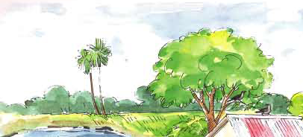

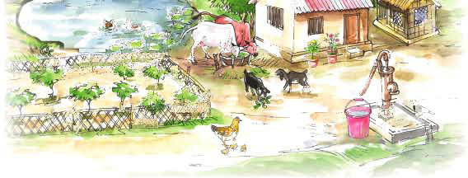

Slide 6

A house

Slide 7
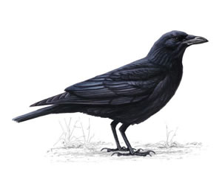
What is this?
It is a crow

Slide 8

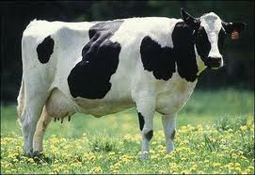
What is this?
It is a cow

Slide 9

What is this?
It is a tub

Slide 10

Keem’s game

Slide 11
Matching word with picture
A crow
A tub
A cow

Slide 12

cow
This is a___________.
crow
This is a ____________.
tub
This is a _____.

Slide 13

Good bye,see you again tomorrow.
Thank you

